Slide 1

TITLE
GOES HERE
Presenter Name, Title goes here

Slide 2

HEADLINE GOES HERE
Slide content and information goes here
And here
And here
And here
And here.

Slide 3


DIVIDER SLIDE
COPY GOES HERE.

Slide 4



SECTION NAME HERE
HEADLINE GOES HERE AND HERE AND MORE
Et veraes dolupti busciis secusti ossequa tquae. Reruptat quam, nobis sit hitem doluptatem rest ernatem qui atectinvero blam, sandae pla volut eum, sim volorestotas enihili tatiam aut as molo doluptam, simagni minciur as aut quis ex eum hillabor reicatumquas versperia que pedit quae eic tessit, nobitati doluptat peditae ide enispe.

Slide 5
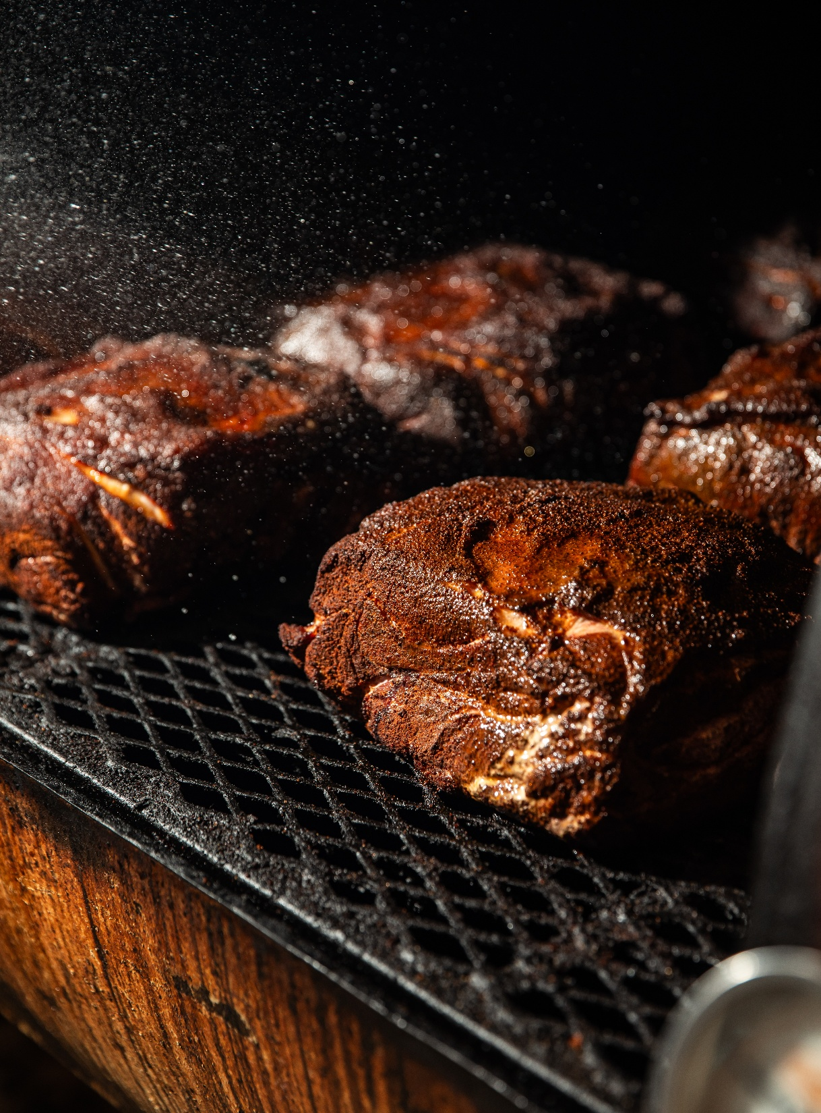

SECTION NAME HERE
HEADLINE GOES HERE AND HERE AND MORE
Et veraes dolupti busciis secusti ossequa tquae. Reruptat quam, nobis sit hitem doluptatem rest ernatem qui atectinvero blam, sandae pla volut eum, sim volorestotas enihili tatiam aut as molo doluptam, simagni minciur as aut quis ex eum hillabor reicatumquas versperia que pedit quae eic tessit, nobitati doluptat peditae ide enispe.

Slide 7
SECTION NAME HERE

Slide 8
TITLE
GOES HERE
Presenter Name, Title goes here

Slide 9
HEADLINE GOES HERE
Slide content and information goes here
And here
And here
And here
This slide format is for text only.

Slide 10
DIVIDER SLIDE
COPY GOES HERE.

Slide 11
SECTION NAME HERE
HEADLINE GOES HERE AND HERE AND MORE
Et veraes dolupti busciis secusti ossequa tquae. Reruptat quam, nobis sit hitem doluptatem rest ernatem qui atectinvero blam, sandae pla volut eum, sim volorestotas enihili tatiam aut as molo doluptam, simagni minciur as aut quis ex eum hillabor reicatumquas versperia que pedit quae eic tessit, nobitati doluptat peditae ide enispe.

Slide 12
SECTION NAME HERE
HEADLINE GOES HERE AND HERE AND MORE
Et veraes dolupti busciis secusti ossequa tquae. Reruptat quam, nobis sit hitem doluptatem rest ernatem qui atectinvero blam, sandae pla volut eum, sim volorestotas enihili tatiam aut as molo doluptam, simagni minciur as aut quis ex eum hillabor reicatumquas versperia que pedit quae eic tessit, nobitati doluptat peditae ide enispe.

Slide 13
SECTION NAME HERE

Slide 14

TITLE
GOES HERE
Presenter Name, Title goes here

Slide 15
HEADLINE GOES HERE
Slide content and information goes here
And here
And here
And here
This slide format is for text only.

Slide 16
DIVIDER SLIDE
COPY GOES HERE.

Slide 17
SECTION NAME HERE
HEADLINE GOES HERE AND HERE AND MORE
Et veraes dolupti busciis secusti ossequa tquae. Reruptat quam, nobis sit hitem doluptatem rest ernatem qui atectinvero blam, sandae pla volut eum, sim volorestotas enihili tatiam aut as molo doluptam, simagni minciur as aut quis ex eum hillabor reicatumquas versperia que pedit quae eic tessit, nobitati doluptat peditae ide enispe.

Slide 18
SECTION NAME HERE
HEADLINE GOES HERE AND HERE AND MORE
Et veraes dolupti busciis secusti ossequa tquae. Reruptat quam, nobis sit hitem doluptatem rest ernatem qui atectinvero blam, sandae pla volut eum, sim volorestotas enihili tatiam aut as molo doluptam, simagni minciur as aut quis ex eum hillabor reicatumquas versperia que pedit quae eic tessit, nobitati doluptat peditae ide enispe.

Slide 19

SECTION NAME HERE

